Slide 1



TEKATHON-5.0- 2026
TITLE PAGE
• ProblemStatementID–26162
• ProblemStatementTitle-AI-Based Detection and Classification of Industrial Fires
• Theme- Disaster Management
• PS Category- Software TeamName:OOPS

Slide 2


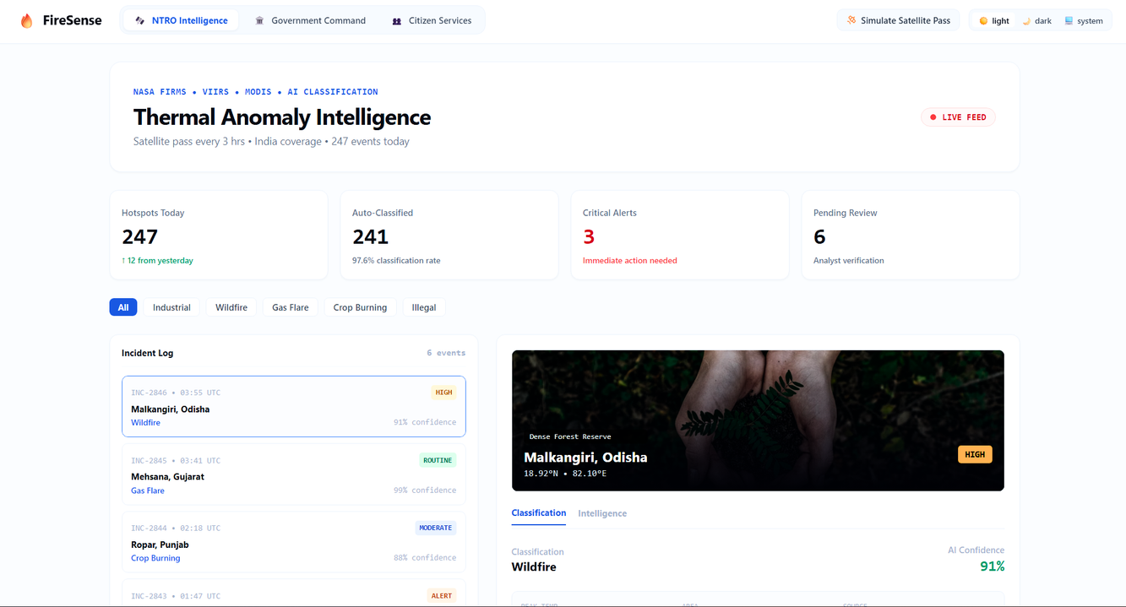
PROPOSED SOLUTION
FireSense— Satellite-to-Ground Incident & Disaster Response
Detect → Classify → Alert → Respond → Track
Automated Thermal Ingestion: Ingests NASA FIRMS (MODIS/VIIRS) hotspots and classifies them into 7 classes — Wildfire, Gas Flare, Power Plant, Mining, Crop Burn, Clandestine.
Confidence & Threat Scoring: Calculates real-time AI Confidence (e.g., 91–97%) and Danger Severity based on peak temperature, spatial area ($km^2$), and temporal baseline matching.
Tri-Tier Coordination: Connects surveillance analysts, government incident commanders, and affected citizens within a single unified pipeline.
End-to-End Action: Moves beyond passive detection by triggering automated emergency resource allocation, dynamic safe evacuation paths, and instant public SOS alerts.
🔭 Detect
🧠 Classify
🚨 Alert
🚒 Respond
✅ Track
NTRO INTELLIGENCE
GOVERNMENT COMMAND
CITIZEN SERVICES
Ingests raw FIRMS feeds & VIIRS thermal passes.
Validates AI confidence & temperatures.
Cross-checks OSM, WorldCover & 60-day persistence.
Real-time awareness across all incident zones.
Lifecycle state machine + one-click dispatch.
Quick actions: alerts, road blocks, notifications.
Live proximity alerts & severity for residents.
Safe evacuation routes avoiding fire corridors.
Crowdsourced smoke/fire reports with GPS + SOS.
Our Website FireSense UI
Real-Time Tri-Tier Sync: Satellite Intelligence ⇄ Command Dispatch ⇄ Citizen Action
4 Demo Scenarios
Malkangiri, Odisha: WILDFIRE
Angul, Odisha: INDUSTRIAL
Ropar, Punjab: CROP SMOKE
Faridabad, Haryana: ILLEGAL
moving NE from forest zone
critical
action needed
CROP SMOKE — CAQM alert
alert status
2
Notes:
1

Slide 3
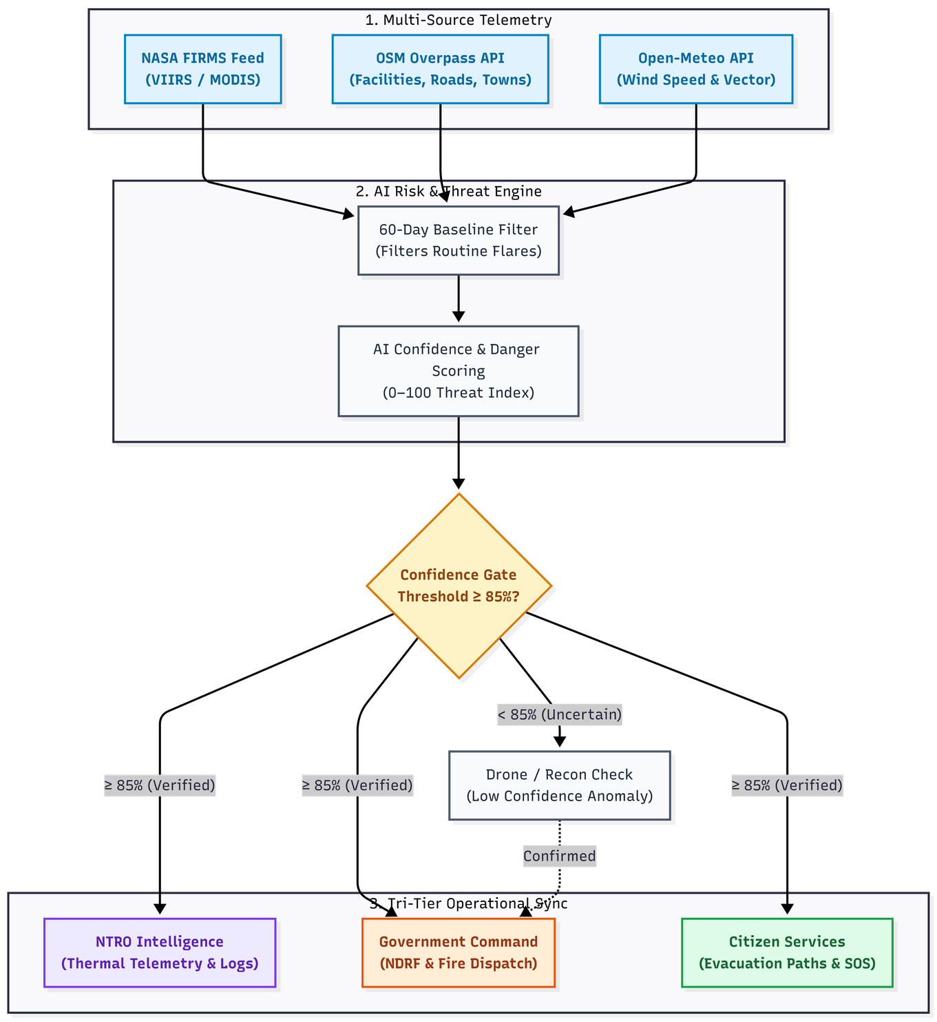
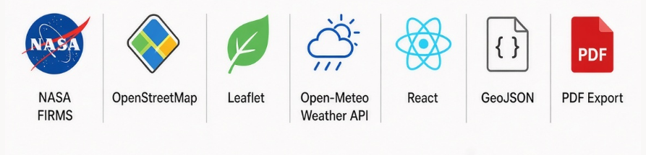
TECHNICAL APPROACH
Risk Scoring & Confidence-Gated Alert Pipeline
System Architecture & Data Flow Diagram (DFD)
1
3
5
Satellite Detect
Verify Confidence
Routes intel to Command (NDRF) & Citizen (evacuation)
NASA FIRMS hotspot
(lat/lon, heat, timestamp)
OSM + ESA WorldCover
context + 60-day multi-pass persistence
2
4
Classify + Score
Context & Spread
7-class AI label + evidence
Confidence % — Danger 0-100
Wind-based danger zone +
villages/roads at risk
Confidence Gate: >85% → Direct Fire-Brigade Alert · <85% → Drone Verification First
Persistence Check: Fire Frequency vs 60-Day Baseline (Anomaly Flag)
Technology Stack
3
Notes:
2

Slide 4
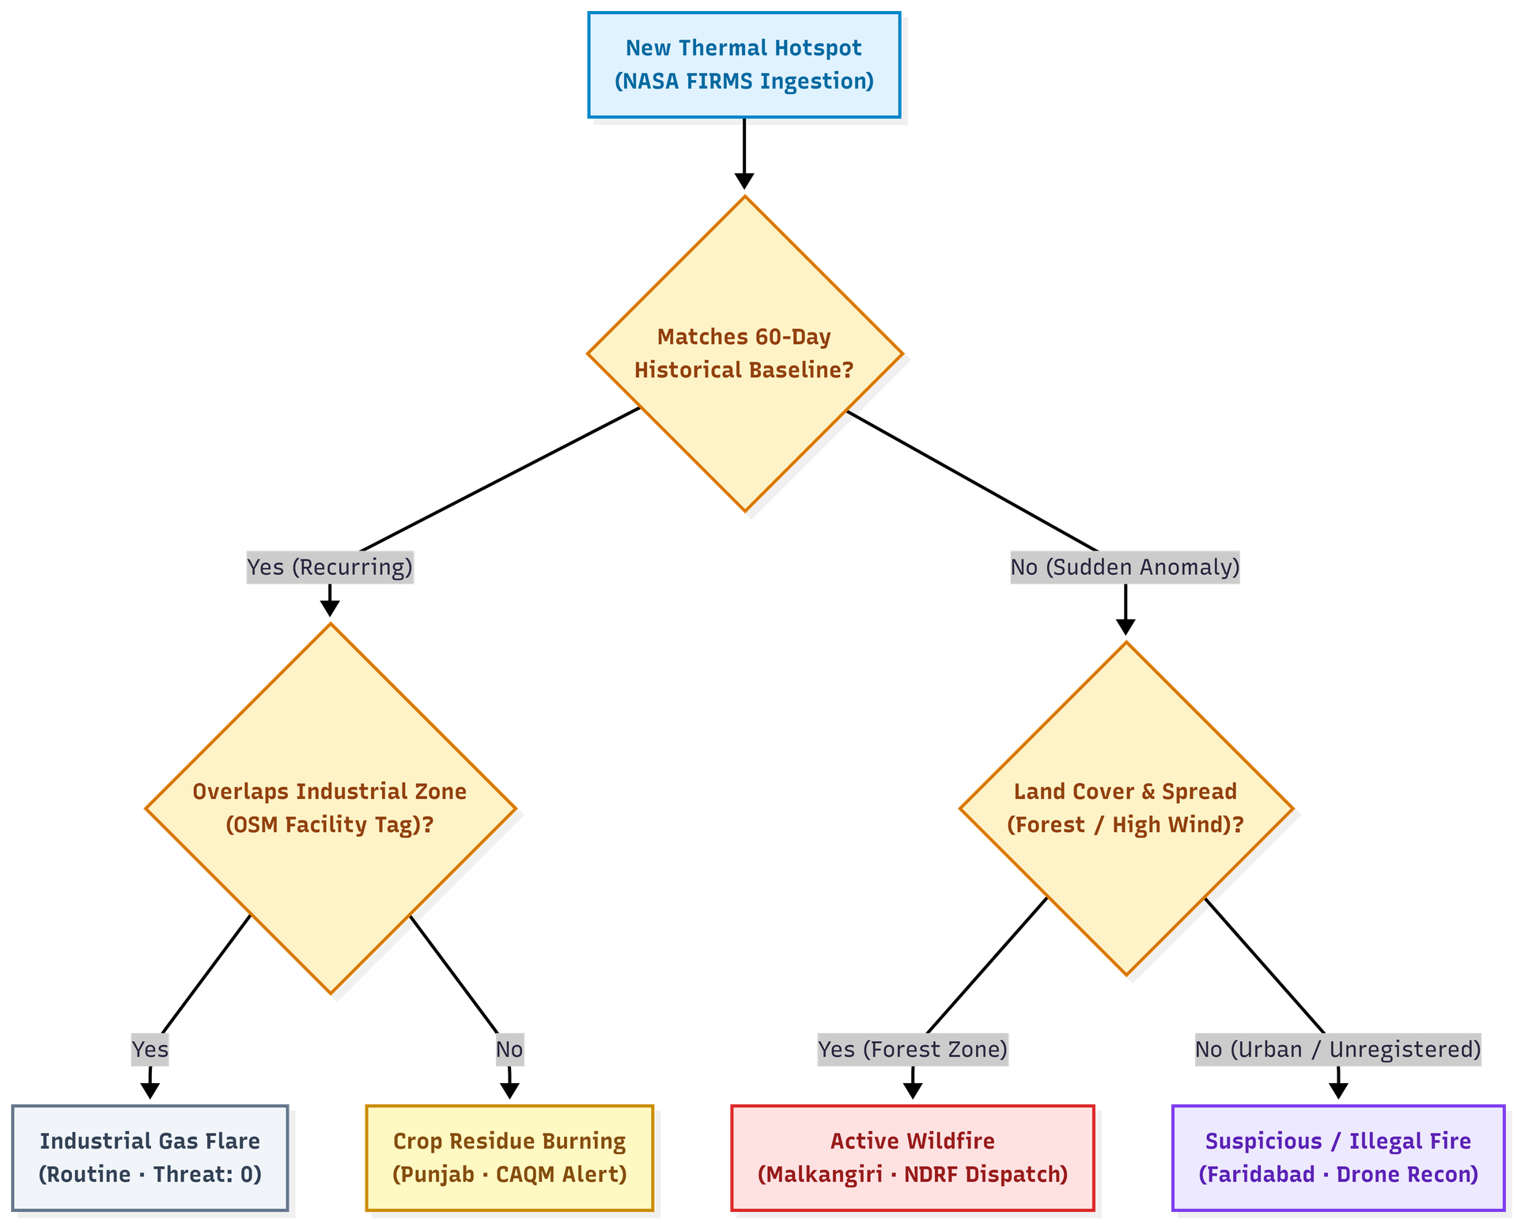
FEASIBILITY AND VIABILITY
FEASIBILITY
VIABILITY
Classification Decision Tree
Runs entirely on free satellite (FIRMS) and open-map (OSM) data — no proprietary sensor network needed.
Confidence-gated alerting and lightweight web dashboards mean no extra field hardware to deploy on day one.
Live prototype deployed end-to-end: detection → alert → dispatch → resolution.
Role-based architecture (NTRO Intelligence / Government Command / Citizen Services) ensures clear, targeted action without cognitive overload.
Scalable to any FIRMS-covered region; onboarding a new agency is a jurisdiction/role config, not a rebuild.
Downloadable PDF reports & GeoJSON exports slot into agency record-keeping.
CHALLENGES & RISKS
STRATEGIES
Distinguishing a real wildfire from a routine licensed industrial flare (e.g. Jamnagar refinery) at a glance.
Field connectivity in remote forest/rural zones can delay live status sync from responders.
Coordinating multiple agencies (fire station + forest range + CAQM + NTRO) on one incident.
Confidence gate + drone-first verification below 85% filters out flares/false alarms before dispatch.
60-day fire-frequency baseline flags "very unusual activity" so genuine anomalies stand out automatically.
Primary + secondary responder fields keep multi-agency coordination explicit.
4
Notes:
3

Slide 5



IMPACT AND BENEFITS
From Satellite Pixel to Fire Engine on the Road — Tracked End-to-End
Every incident carries a danger score, confidence rating, nearest responder + ETA, and a live lifecycle status — not a raw coordinate.
Malkangiri wildfire — 91% confidence triggers Government Command to deploy NDRF teams and activates safe evacuation routes on the Citizen Services portal.
SOCIAL
ECONOMIC
ENVIRONMENTAL
Faster, targeted wildfire response protects villages directly in the danger zone.
Citizen Services portal provides live evacuation routes, nearest shelters, and SOS features for affected communities.
Confidence gating avoids costly false dispatches to routine industrial flares.
Zero-cost satellite/OSM data keeps operating cost near zero for agencies.
Early wildfire containment (e.g. Similipal) limits forest and wildlife loss.
Crop-burning alerts feed CAQM action, supporting regional air-quality control.
5
Notes:
4

Slide 6
RESEARCH AND REFERENCES
Sources
LIVE PROTOTYPE
1. NASA FIRMS (Primary Data Source)
NASA FIRMS Official Site
https://firms.modaps.eosdis.nasa.gov/
Active Fire Data Attributes (MODIS & VIIRS)
https://www.earthdata.nasa.gov/data/tools/firms/active-fire-data-attributes-modis-viirs
2. OpenStreetMap
https://dev.overpass-api.de/overpass-doc/en/
3. Weather / Wind Data
Open-Meteo Weather API (Free)
https://open-meteo.com/
4. Mapping
Leaflet.js Official Documentation
https://leafletjs.com/
5. Supporting Context
NASA LANCE (Land, Atmosphere Near real-time Capability for EO)
https://www.earthdata.nasa.gov/data/tools/firms
6. ESA WorldCover (Land-Cover Context)
ESA WorldCover 2021 Product
https://esa-worldcover.org/en
sih-thermal-intel.vercel.app
Live NTRO Intelligence, Government Command & Citizen Services views with 4 working demo scenarios.
Team: OOPS
Problem Statement ID: SIH26162
Agency Partner: NTRO
https://youtube.com/playlist?list=PLZEVJ_CP2S9I&si=SveV-co1Jjo9PfHF
6
Notes:
5

